Slide 1


Dishcover
An Interactive Mobile Cookbook
Jesper Riemer Andersen
Sam Sepstrup Olesen
Simon Reedtz Olesen
Jacob Karstensten Wortmann
Nicklas Andersen

Slide 2
Agenda
Analysis
Design
Login
Model Component
Search Algorithm
Test
Conclusion
Demonstration
2 OF 32 | 15.02.2014
Department of computer science
AALBORG UNIVERSITy

Slide 3
Analysis
Sam Sepstrup Olesen

Slide 4
Analysis
design
login
Model
Search
test
conclusion
demonstration
Motivation
Other solutions does not satisfy our needs
Increasing number of mobile devices
A digital cookbook might provide more functionality
Search
Filtering
Suggestions
4 OF 32 | 15.02.2014
Department of computer science
AALBORG UNIVERSITy

Slide 5
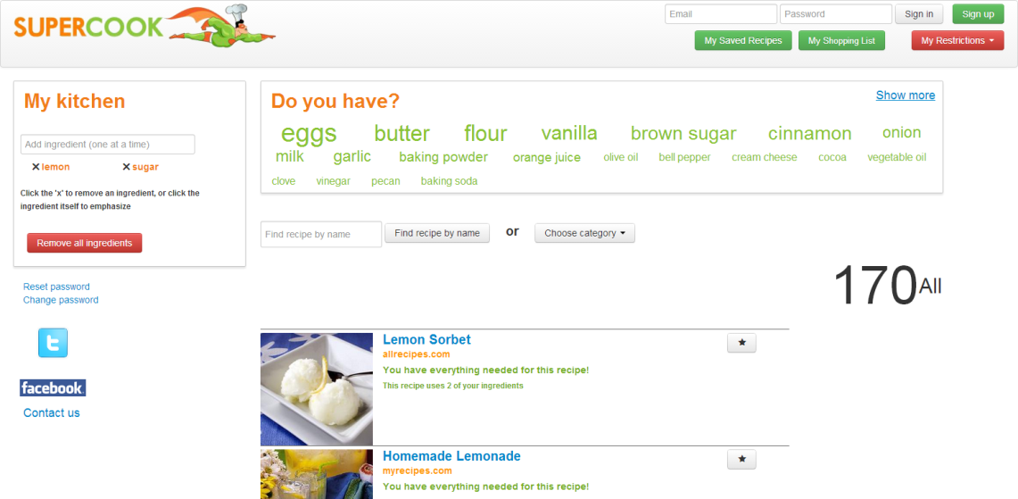
Analysis
design
login
Model
Search
test
conclusion
demonstration
Supercook
Web application
PROS
Word cloud
Search recipes by ingredients
CONS
ordering of recipes
5 OF 32 | 15.02.2014
Department of computer science
AALBORG UNIVERSITy

Slide 6
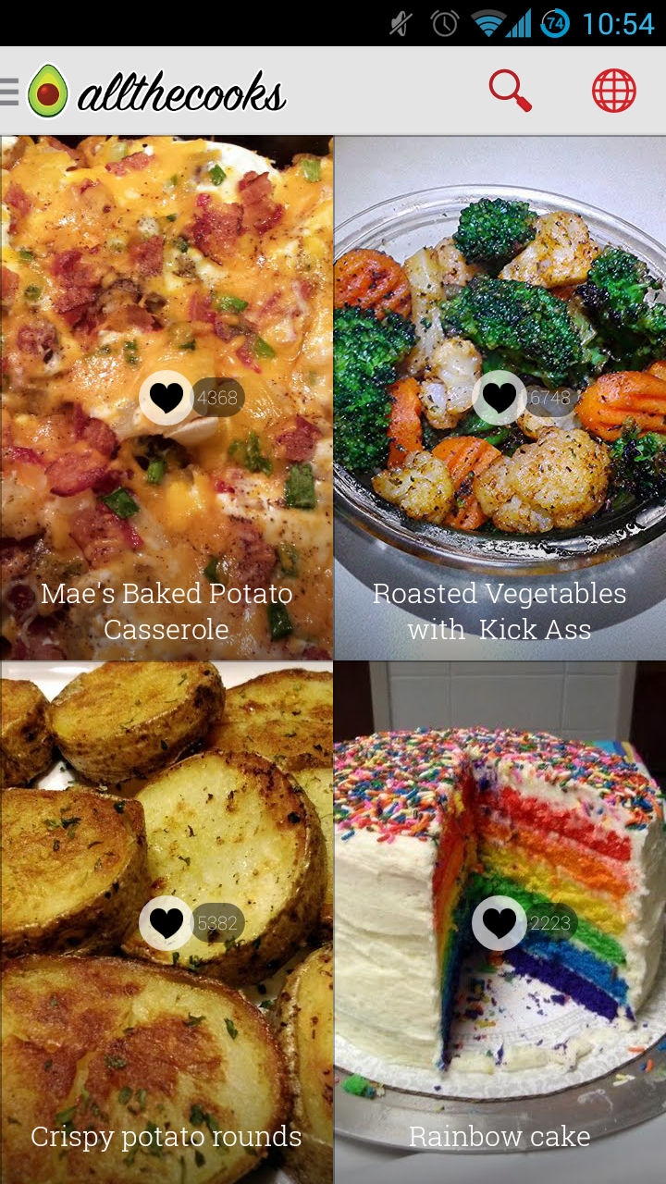
Analysis
design
login
Model
Search
test
conclusion
demonstration
Allthecooks
Android application
Pros
Beautiful design
Filtering search results
Favourite and shopping list
Cons
Have not implemented
search by ingredients
6 OF 32 | 15.02.2014
Department of computer science
AALBORG UNIVERSITy

Slide 7
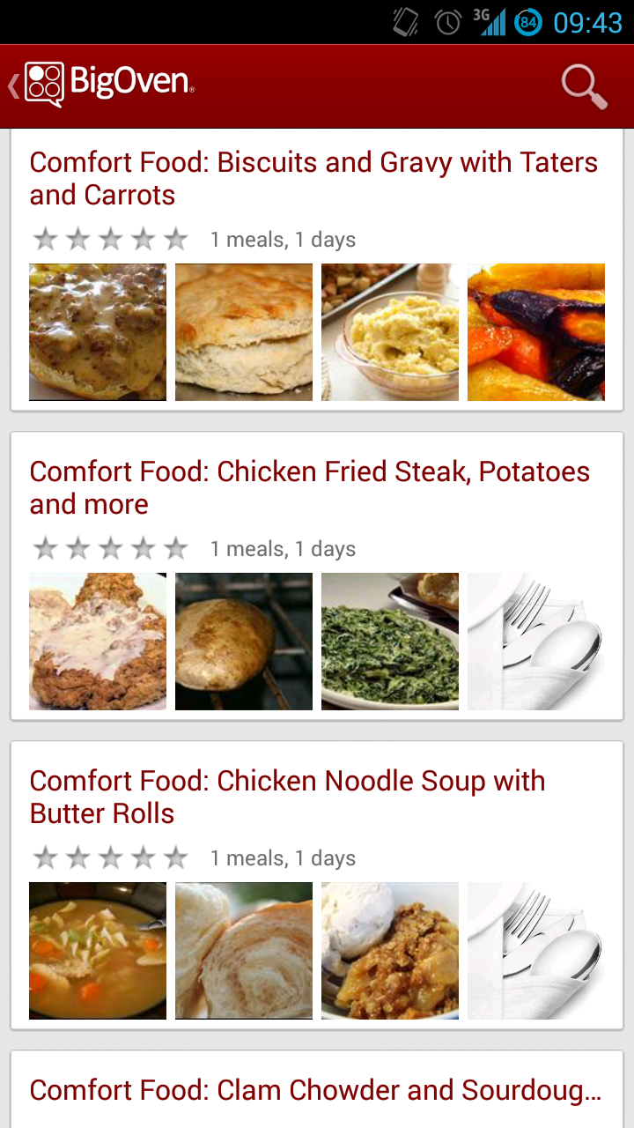
Analysis
design
login
Model
Search
test
conclusion
demonstration
BigOven
Android application
Pros
Menu-cards
Simple search by ingredients
Favourite and shopping list
Cons
Design and structure is cluttered
Hard to find the wanted functionality
7 OF 32 | 15.02.2014
Department of computer science
AALBORG UNIVERSITy

Slide 8
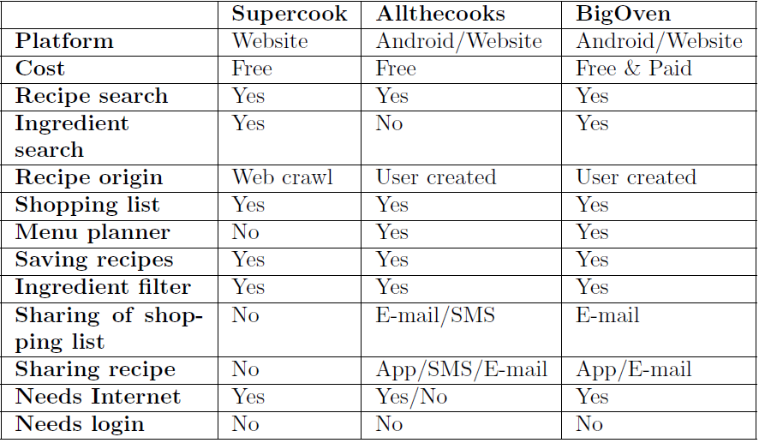
Analysis
design
login
Model
Search
test
conclusion
demonstration
Comparison
8 OF 32 | 15.02.2014
Department of computer science
AALBORG UNIVERSITy

Slide 9
Analysis
design
login
Model
Search
test
conclusion
demonstration
Problem Statement
“How can we take advantage of the mobile platform in order to provide the user with relevant recipes based one specific ingredients, and taking any user defined restrictions, like allergies, into consideration.”
9 OF 32 | 15.02.2014
Department of computer science
AALBORG UNIVERSITy

Slide 10
Analysis
design
login
Model
Search
test
conclusion
demonstration
Requirements
Android
Search by ingredients
Free-teXt search
Search filters
Favourite recipes
Shopping List
Sharing
Persistency
Unit Conversion
Additional Languages
No login required
10 OF 32 | 15.02.2014
Department of computer science
AALBORG UNIVERSITy

Slide 11
Design
Nicklas Andersen

Slide 12
analysis
design
login
Model
Search
test
conclusion
demonstration
Architecture
12 OF 32 | 15.02.2014
Department of computer science
AALBORG UNIVERSITy

Slide 13
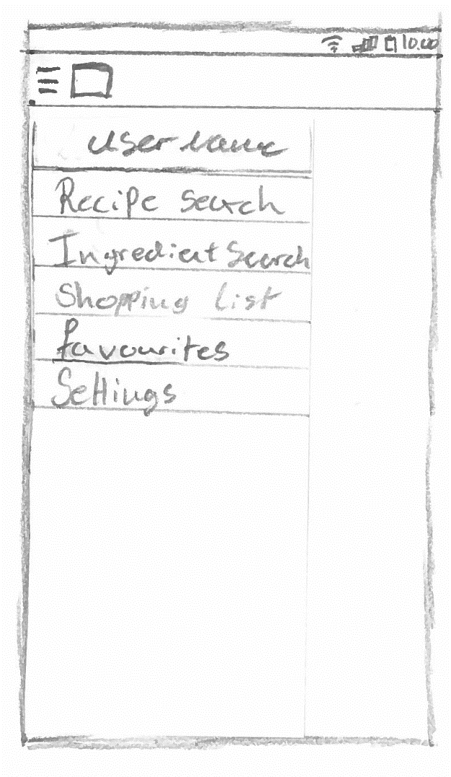
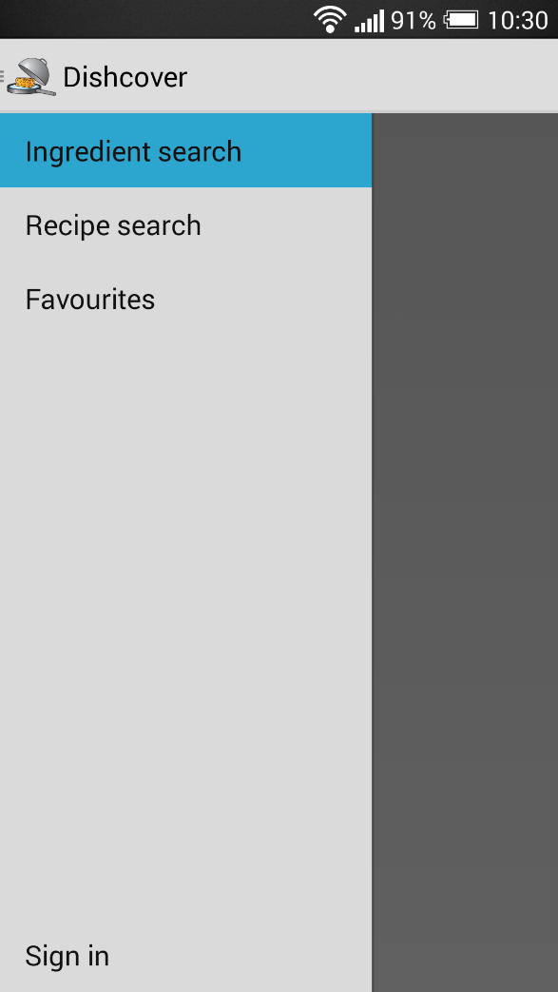
analysis
design
login
Model
Search
test
conclusion
demonstration
Navigation drawer
9 OF 32 | 15.02.2014
Department of computer science
AALBORG UNIVERSITy

Slide 14
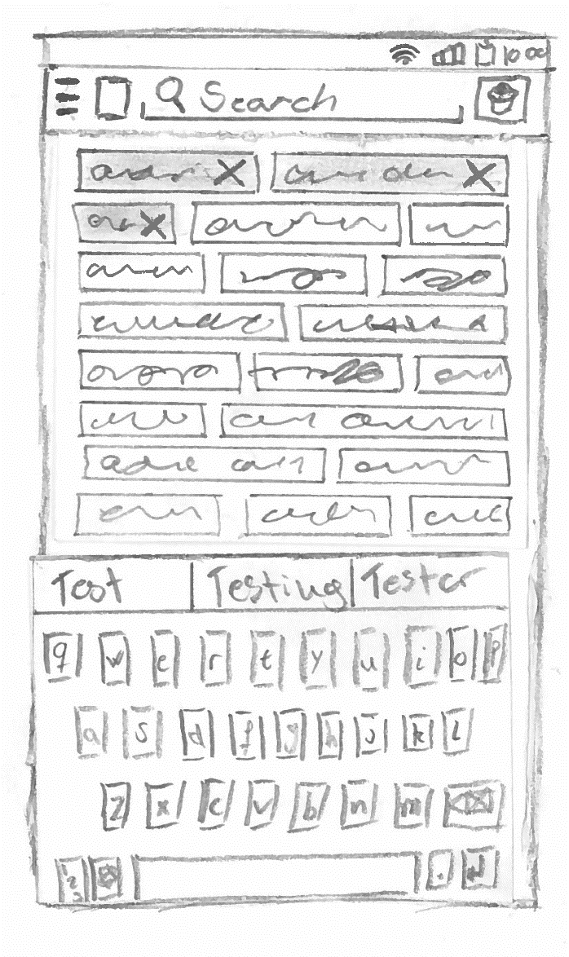
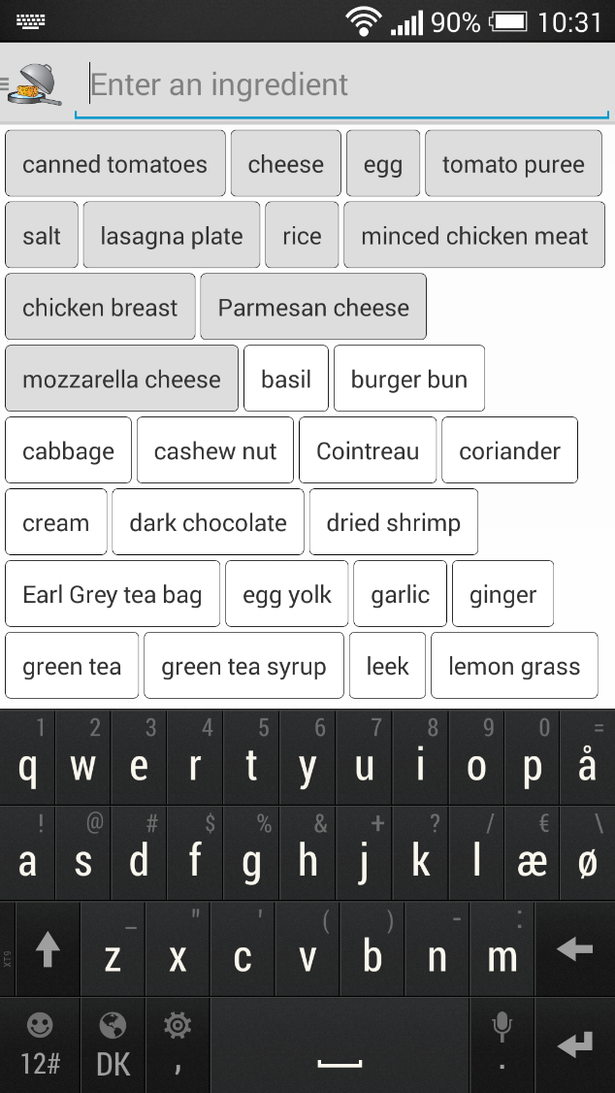
analysis
design
login
Model
Search
test
conclusion
demonstration
Search by ingredient
10 OF 32 | 15.02.2014
Department of computer science
AALBORG UNIVERSITy

Slide 15
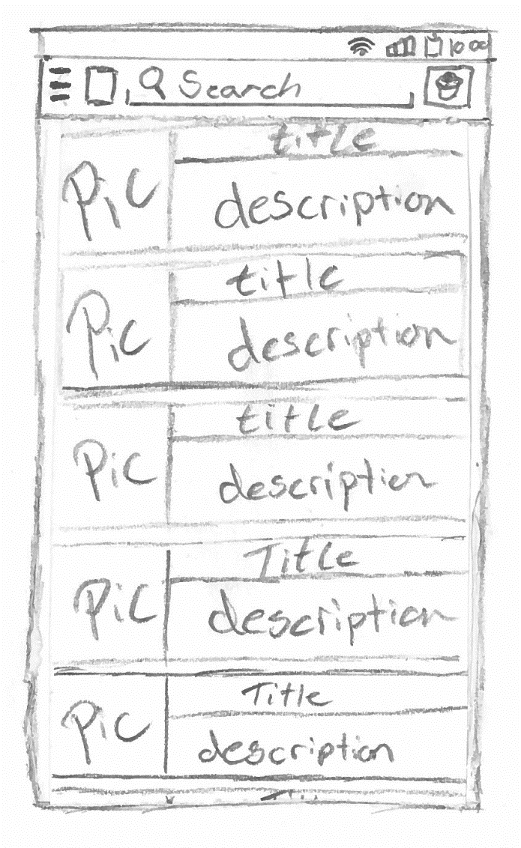
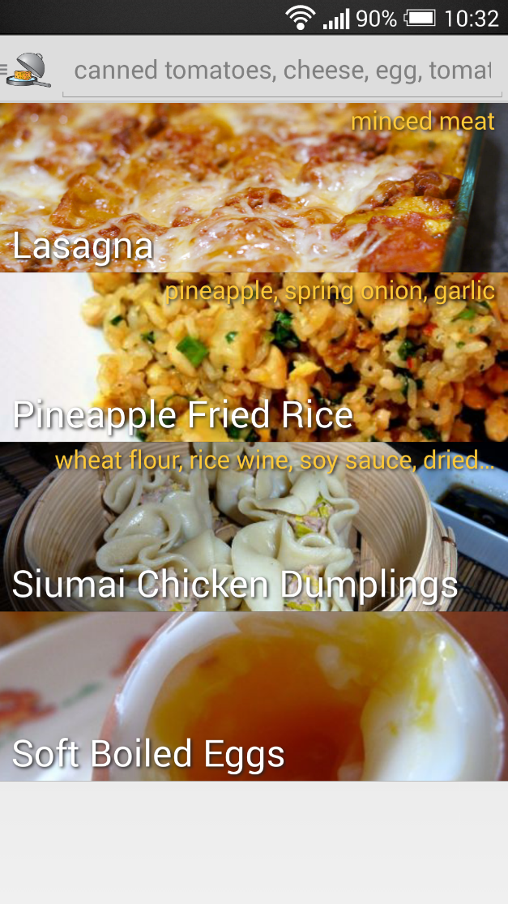
analysis
design
login
Model
Search
test
conclusion
demonstration
Result list
11 OF 32 | 15.02.2014
Department of computer science
AALBORG UNIVERSITy

Slide 16
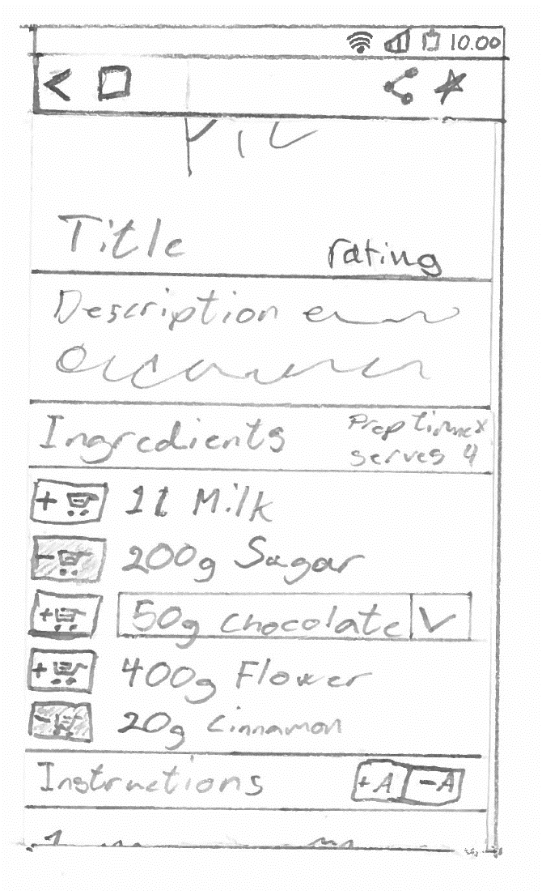
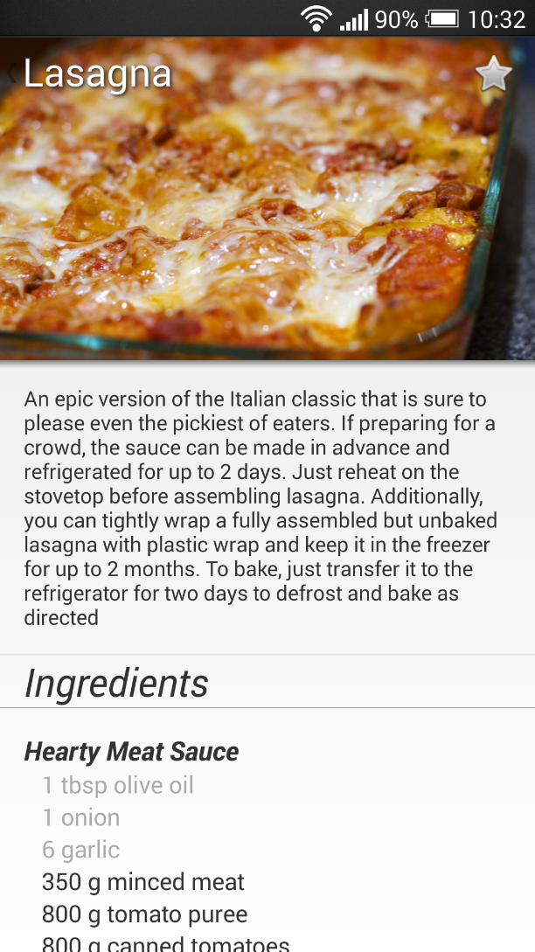
analysis
design
login
Model
Search
test
conclusion
demonstration
Recipe
12 OF 32 | 15.02.2014
Department of computer science
AALBORG UNIVERSITy

Slide 17

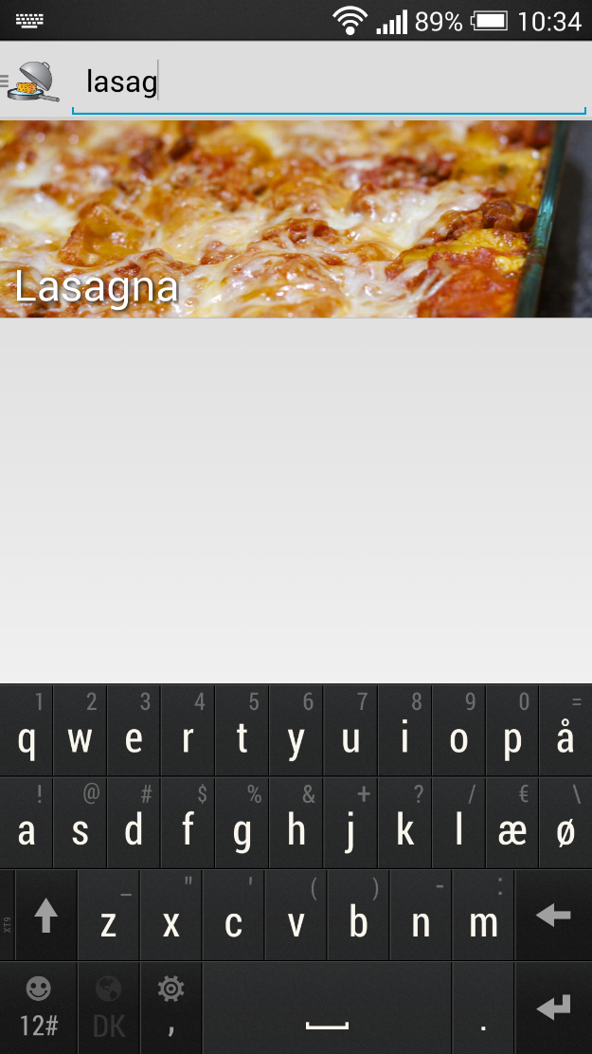
analysis
design
login
Model
Search
test
conclusion
demonstration
Text search
13 OF 32 | 15.02.2014
Department of computer science
AALBORG UNIVERSITy

Slide 18
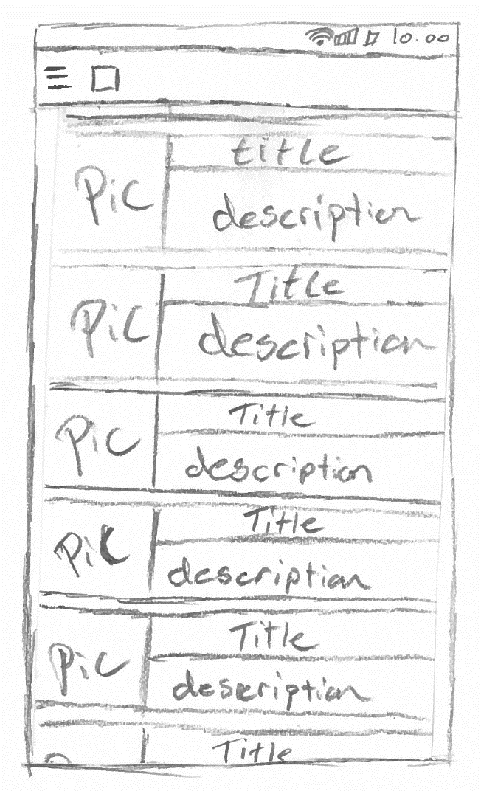
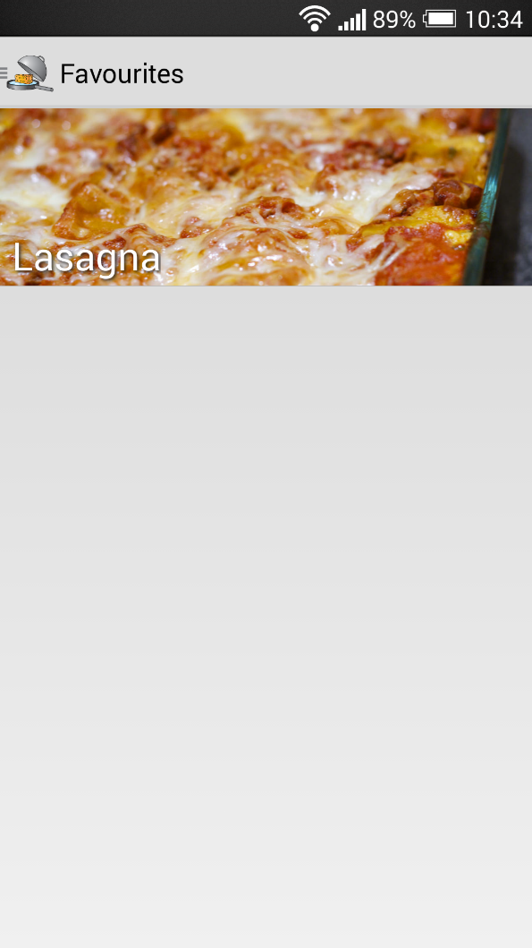
analysis
design
login
Model
Search
test
conclusion
demonstration
Favourites
14 OF 32 | 15.02.2014
Department of computer science
AALBORG UNIVERSITy

Slide 19
Login
Simon Reedtz Olesen

Slide 20
analysis
design
login
Model
Search
test
conclusion
demonstration
Social Media
Social media sign-ins
We use sign-in to identify the user
Remove the security measures
We use Google+
20 OF 32 | 15.02.2014
Department of computer science
AALBORG UNIVERSITy

Slide 21
analysis
design
login
Model
Search
test
conclusion
demonstration
Server Api
To get the status of a recipe we use the following URI:
http://figz.dk/food/lib/favourites.php? action=status& recipeid=4& hash=d74df7a0c28526d5c811465046e455f33c0b3db5989c533c5b4576e2900e36c4
Hash is the user’s email hashed.
21 OF 32 | 15.02.2014
Department of computer science
AALBORG UNIVERSITy

Slide 22
analysis
design
login
Model
Search
test
conclusion
demonstration
Server Api
The server receives the client call
Action is “status”
The method Favouritestatus($recipeid, $hash) is called
Finds/creates the user(hash) in the database
Tries find the recipeid in the user’s list of favourites
Returns the result
22 OF 32 | 15.02.2014
Department of computer science
AALBORG UNIVERSITy

Slide 23
Model Component
Simon Reedtz Olesen

Slide 24
analysis
design
login
model
Search
test
conclusion
demonstration
Model Component
the model resembles the relational database
24 OF 32 | 15.02.2014
Department of computer science
AALBORG UNIVERSITy

Slide 25
analysis
design
login
model
Search
test
conclusion
demonstration
Model Component
25 OF 32 | 15.02.2014
Department of computer science
AALBORG UNIVERSITy

Slide 26
Entity-Relationship Diagram
26 OF 32 | 15.02.2014
Department of computer science
AALBORG UNIVERSITy

Slide 27
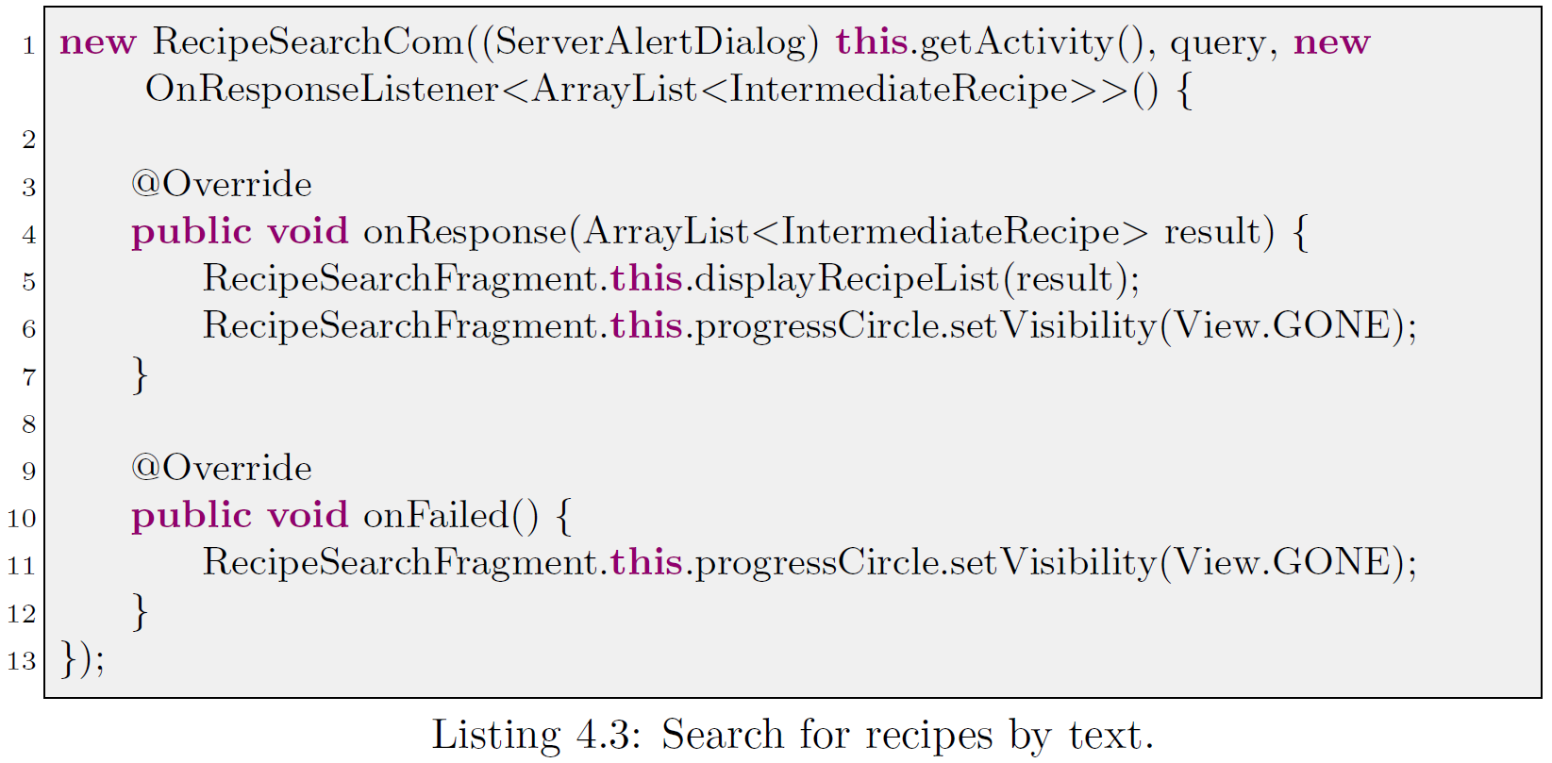
analysis
design
login
model
Search
test
conclusion
demonstration
Server Communication
ServerComTask
Asynchronous
27 OF 32 | 15.02.2014
Department of computer science
AALBORG UNIVERSITy

Slide 28
Search Algorithm
Jesper Riemer Andersen

Slide 29
analysis
design
login
model
search
test
conclusion
demonstration
Search by ingredients
Precedence function
Remove recipes without any matching ingredients.
Sort by least missing optional ingredients.
Sort by most matching optional ingredients.
Sort by least missing mandatory ingredients.
Sort by most matching mandatory ingredients.
6 OF 32 | 15.02.2014
Department of computer science
AALBORG UNIVERSITy
Notes:
- So to show our application we decided to create an exhibition.
Firstly the organiser create the floor plan with our website tool, and while also doing creating data for the android application.
- When the exhibition is ready, users can scan a sepcial NFC tag to enter the exhibition.
- The user can subscribe to different booths to gain relavant information. The users receives information by feeds, the feeds are
created by booths. The users only receives feeds from booths they are subscribed to.
- The user can also see a schedule of the exhibition, that are sceduled ahead of time, this could be presentation of a new
product.
- With the help of the floor plan the user can also navigate to different booths, he uses the NFC tags to tell the application about
his current location.

Slide 30
analysis
design
login
model
search
test
conclusion
demonstration
Matching ingredients
Calculate how many of the user specified ingredients exists in each recipe.
Find all quantities that contains an ingredient specified by the user. $quantityQuery
Check Whether each quantity appear as a part of a mandatory and/or an optional exchangeable. $ingredientQuery
Count the number of distinct matching mandatory and optional ingredients for each recipe. $matchingQuery
6 OF 32 | 15.02.2014
Department of computer science
AALBORG UNIVERSITy
Notes:
- So to show our application we decided to create an exhibition.
Firstly the organiser create the floor plan with our website tool, and while also doing creating data for the android application.
- When the exhibition is ready, users can scan a sepcial NFC tag to enter the exhibition.
- The user can subscribe to different booths to gain relavant information. The users receives information by feeds, the feeds are
created by booths. The users only receives feeds from booths they are subscribed to.
- The user can also see a schedule of the exhibition, that are sceduled ahead of time, this could be presentation of a new
product.
- With the help of the floor plan the user can also navigate to different booths, he uses the NFC tags to tell the application about
his current location.

Slide 31
analysis
design
login
model
search
test
conclusion
demonstration
Missing ingredients
Calculate how many not covered exchangeables exists in each recipe.
$lackingQuery
Find all exchangeables that does not contain an ingredient specified by the user or an ignored ingredient.
Count the number of mandatory and optional exhangeables for each recipe.
6 OF 32 | 15.02.2014
Department of computer science
AALBORG UNIVERSITy
Notes:
- So to show our application we decided to create an exhibition.
Firstly the organiser create the floor plan with our website tool, and while also doing creating data for the android application.
- When the exhibition is ready, users can scan a sepcial NFC tag to enter the exhibition.
- The user can subscribe to different booths to gain relavant information. The users receives information by feeds, the feeds are
created by booths. The users only receives feeds from booths they are subscribed to.
- The user can also see a schedule of the exhibition, that are sceduled ahead of time, this could be presentation of a new
product.
- With the help of the floor plan the user can also navigate to different booths, he uses the NFC tags to tell the application about
his current location.

Slide 32
analysis
design
login
model
search
test
conclusion
demonstration
Sort result
Order the result according to the precedence function.
$sortingQuery
Recipe | Mandatory matching | Mandatory missing | Optional matching | Optional missing
Boiled egg | 1 | 0 | 0 | 0
Cookies | 4 | 1 | 0 | 3
Ice cream | 2 | 3 | 1 | 1
Bread | 4 | 3 | 1 | 2
Recipe | Mandatory matching | Mandatory missing | Optional matching | Optional missing
Cookies | 4 | 1 | 0 | 3
Bread | 4 | 3 | 1 | 2
Ice cream | 2 | 3 | 1 | 1
Boiled egg | 1 | 0 | 0 | 0
6 OF 32 | 15.02.2014
Department of computer science
AALBORG UNIVERSITy
Notes:
- So to show our application we decided to create an exhibition.
Firstly the organiser create the floor plan with our website tool, and while also doing creating data for the android application.
- When the exhibition is ready, users can scan a sepcial NFC tag to enter the exhibition.
- The user can subscribe to different booths to gain relavant information. The users receives information by feeds, the feeds are
created by booths. The users only receives feeds from booths they are subscribed to.
- The user can also see a schedule of the exhibition, that are sceduled ahead of time, this could be presentation of a new
product.
- With the help of the floor plan the user can also navigate to different booths, he uses the NFC tags to tell the application about
his current location.

Slide 33
Test
Jacob Karstensen Wortmann

Slide 34
analysis
design
login
model
search
test
conclusion
demonstration
Black-Box
Test Cases
Procedures
Success Criteria
Case Results
Shopping List not implemented
34 OF 32 | 15.02.2014
Department of computer science
AALBORG UNIVERSITy

Slide 35
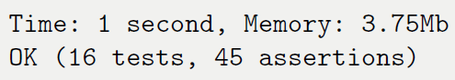
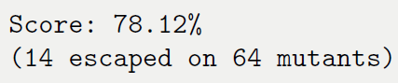
analysis
design
login
model
search
test
conclusion
demonstration
White-Box
Unit Test
Server
Code Coverage
Mutation Testing
Code Coverage vs. Mutation
35 OF 32 | 15.02.2014
Department of computer science
AALBORG UNIVERSITy

Slide 36
Conclusion
Jacob Karstensen Wortmann

Slide 37
analysis
design
login
model
search
test
conclusion
demonstration
Conclusion
The application provides relevant recipes based on ingredients
Powered by a search algorithm
Easy to navigate
Support for free-text search
User can login using Google+
Confident that the server returns correct results
31 OF 32 | 15.02.2014
Department of computer science
AALBORG UNIVERSITy

Slide 38
Future Work
Jacob Karstensen Wortmann

Slide 39
analysis
design
login
model
search
test
conclusion
demonstration
Future work
Shopping list
Start page
Recipe filters
Sharing
Recipe cache
Recipe license
Conversion
Recipe references
Settings
Scaling of recipes
Intelligent sort of ingredients
User created recipes
Localisation
Log interesting ingredient searches
Revoke Google account access
39 OF 32 | 15.02.2014
Department of computer science
AALBORG UNIVERSITy

Slide 40
Demonstration
Jacob Karstensen Wortmann

